Slide 1


A spoken dialogue program for second language learning
ENGL 516 Stone Chen
https://zhichen-isu.github.io/

Slide 2
Introduction
Communicative Language Teaching (CLT) is widely accepted as an effective second language teaching approach.
Task-based Language Teaching (TBLT) has become a leading pedagogical and syllabus design approach.
Computer-assisted Language Learning (CALL) has been using TBLT as a suitable framework for courseware designs.
Automatic Speech Recognition (ASR) and Text to Speech (TTS) technologies have been used in CALL systems to promote oral practices.
Dual coding theory suggests people learn better from words and pictures presented together.

Slide 3
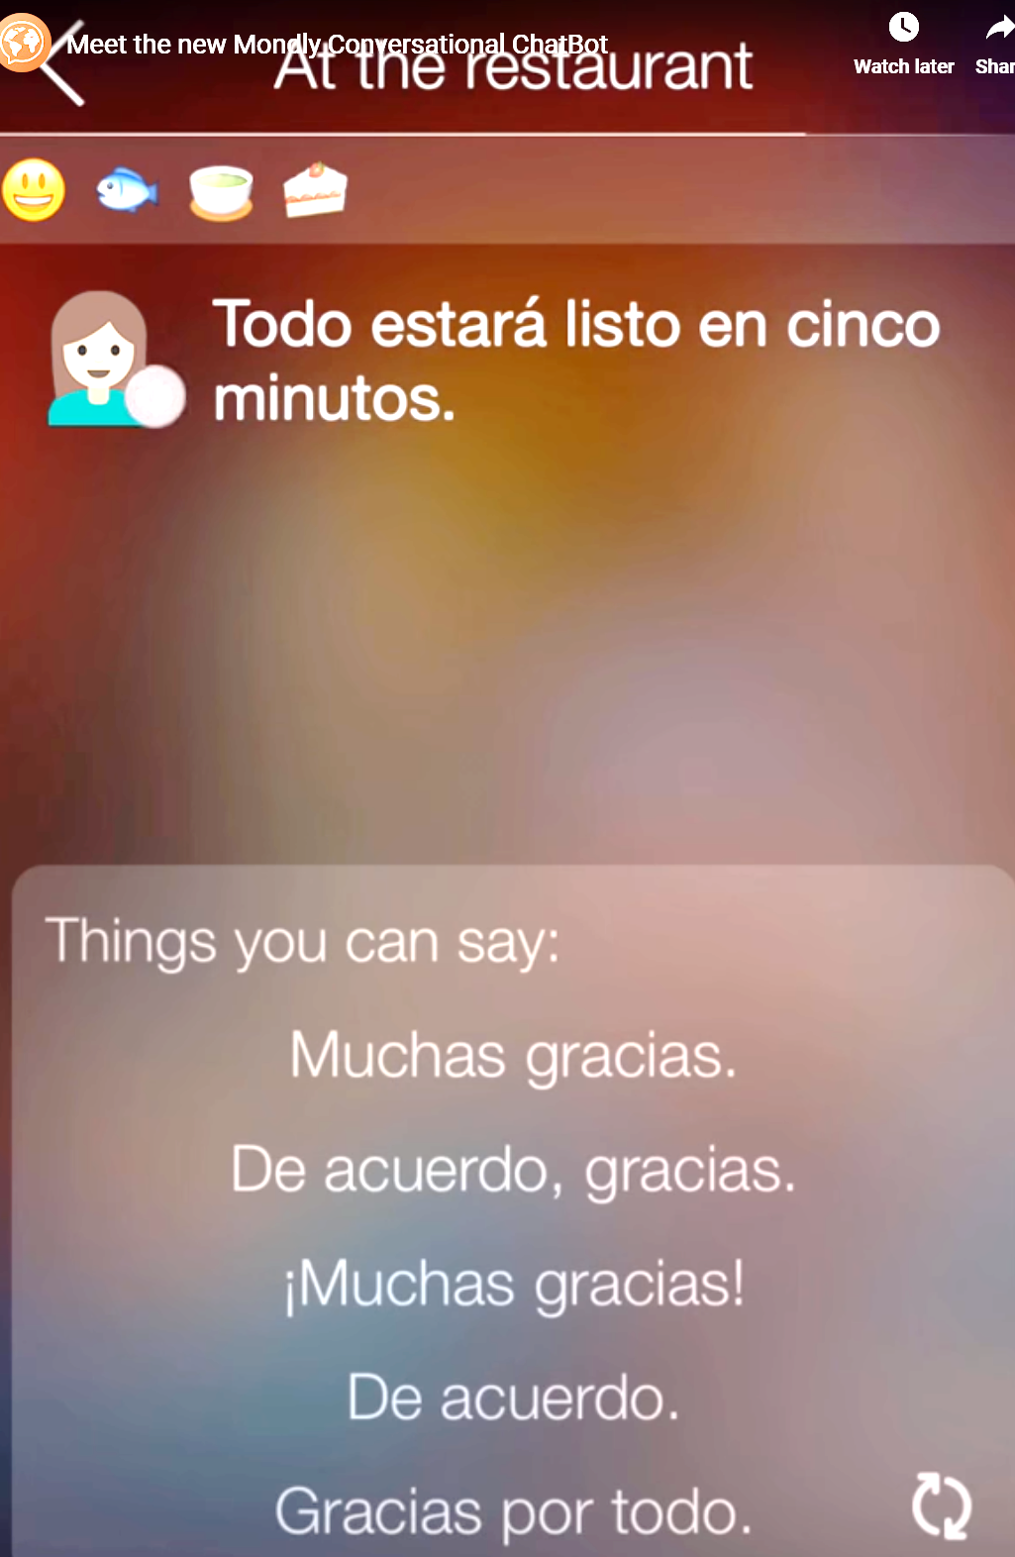
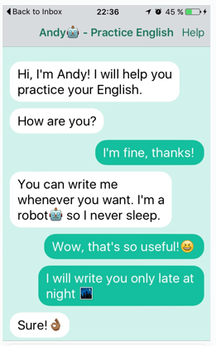
Importance of the project
ASR has been adopted Computer-assisted pronunciation training (CAPT) systems, but not fully utilized in Tutorial CALL systems.
TTS has not been widely used in CALL systems.
Visual aids are used widely in CALL systems but mostly passive.
Using TBLT as framework, the present project integrates ASR, TTS and interactive visual aids to enable users complete language learning conversation task with the computer.
The current task simulates a dialogue in real situation by guiding the user to order a meal at a fast food restaurant. It is most suitable for low or intermediate level English learners.
Pronunciation based voice chats
Text based
chatbot

Slide 4



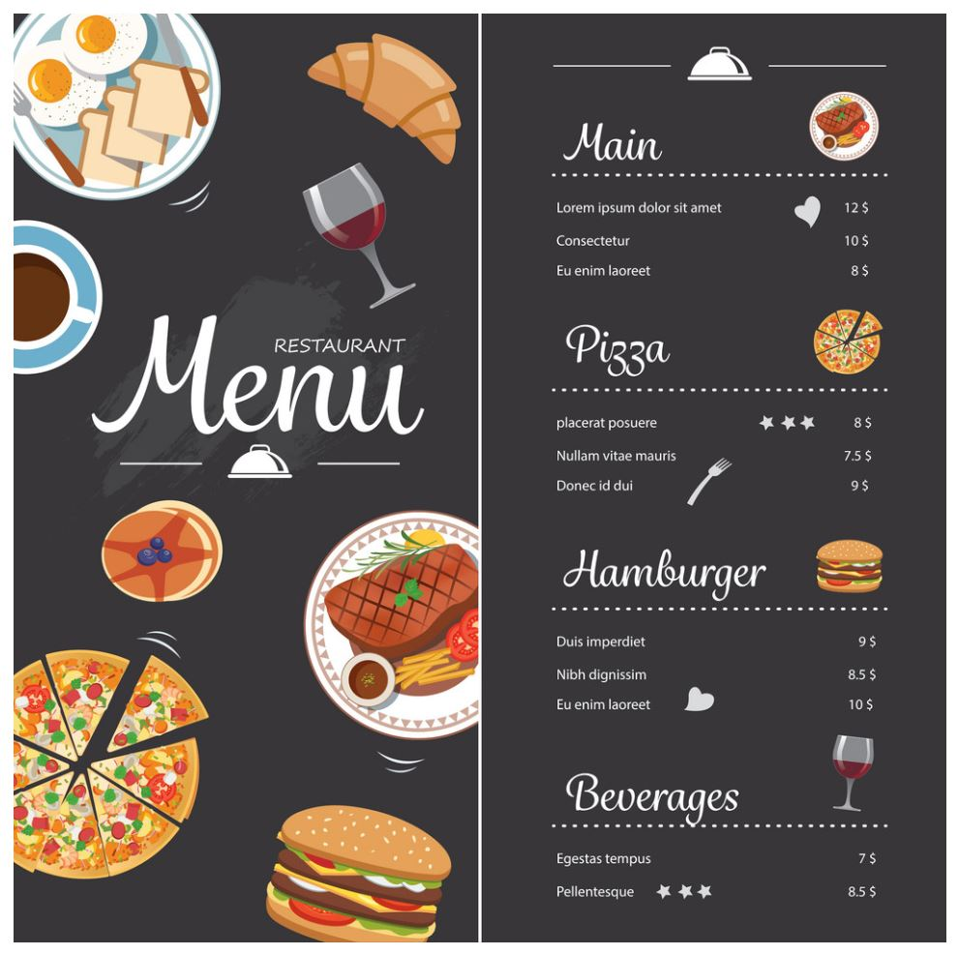

Program design
Hear
replies
Chrome
Speech
Synthesis
Ask user to clarify
Spoken task reply bank
{ […], […], […] }
Animation Functions
CCS
yes
Say
command
Chrome
Speech
Recognition
Match with target
keywords list
/ foodA || foodB || … /
no
https://zhichen-isu.github.io/

Slide 5
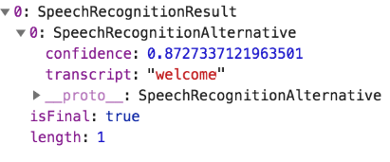
Programming Process
Speech Recognition
https://developer.mozilla.org/en-US/docs/Web/API/SpeechRecognition
var SpeechRecognition = SpeechRecognition || webkitSpeechRecognition;
var SpeechGrammarList = SpeechGrammarList || webkitSpeechGrammarList;
var grammar = '#JSGF V1.0;'
var recognition = new SpeechRecognition ( );
var speechRecognitionList = new SpeechGrammarList ( );
speechRecognitionList.addFromString (grammar, 1);
recognition.grammars = speechRecognitionList;
recognition.lang = 'en-US’;
recognition.interimResults = false; //by default
recognition.continuous = false;
recognition.onresult = function (event) {
let recString = event.results [0] [0].transcript;
message.textContent = ' You said: ' + recString + '.';
command = recString.toLowerCase ( );

Slide 6
if (command.match (/salad | coffee | hamburger | burger | fries | juice | pizza | thanks?/) == null) {
let reply = replyBank.others [Math.floor(Math.random ( ) * replyBank.others.length)];
speechSynthesis.speak (new SpeechSynthesisUtterance (reply));
answer.textContent = "Reply: " + reply;
} else {
let keyword = command.match (/salad | coffee | hamburger | burger | fries | juice | pizza | thanks?/);
if (keyword [0] === "salad") {
myMove (0,0);
count ++;
bill + = 4.0;
}
if (keyword [0] === "coffee") {
myMove (1,1);
count ++;
bill + = 2.5;
}
…
if(count > 2) {
let replyTotal = "Your total is "
+ bill + " dollars";
}
function myMove (a,b) {
item = Object.keys (replyBank)
newId = item [a];
let elem = document.getElementById (newId);
let position = 150;
let id = setInterval (frame, 4);
function frame ( ) {
if (position == 500) {
clearInterval (id);
} else {
position ++;
elem.style.top = position + "px";
elem.style.left = 53 + position * b/2 + "px";
}
}
//newId is the intended picture name
//style.top move vertical by # of pixels
//style.left move horizontal by # of pixels
https://www.w3schools.com/howto/howto_js_animate.asp

Slide 7
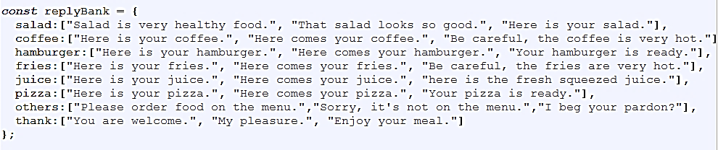

let reply = replyBank [newId] [Math.floor (Math.random( ) * replyBank [newId].length)];
answer.textContent = "Reply: " + reply;
speechSynthesis.speak (new SpeechSynthesisUtterance (reply));
document.querySelector ('#btnGiveCommand').addEventListener ('click', function( ) { recognition.start ( );});
setTimeout (function ( ) {document.getElementById ('btnGiveCommand').click ( );}, 3000);

Slide 8
Limitations
The conversation is limited to ordering the food items on the menu.
The program can only recognize target keywords and was not set up to recognize the whole sentence. This can be done by building a complexed keyword bank.
The program cannot provide corrective feedbacks to users.
When there is a long pause at the beginning or in the middle of the sentence, ASR may have difficulties recognizing the speech or stops the recognition automatically.
Speech Synthesis has a lower voice quality compare to real people.

